Slide 1
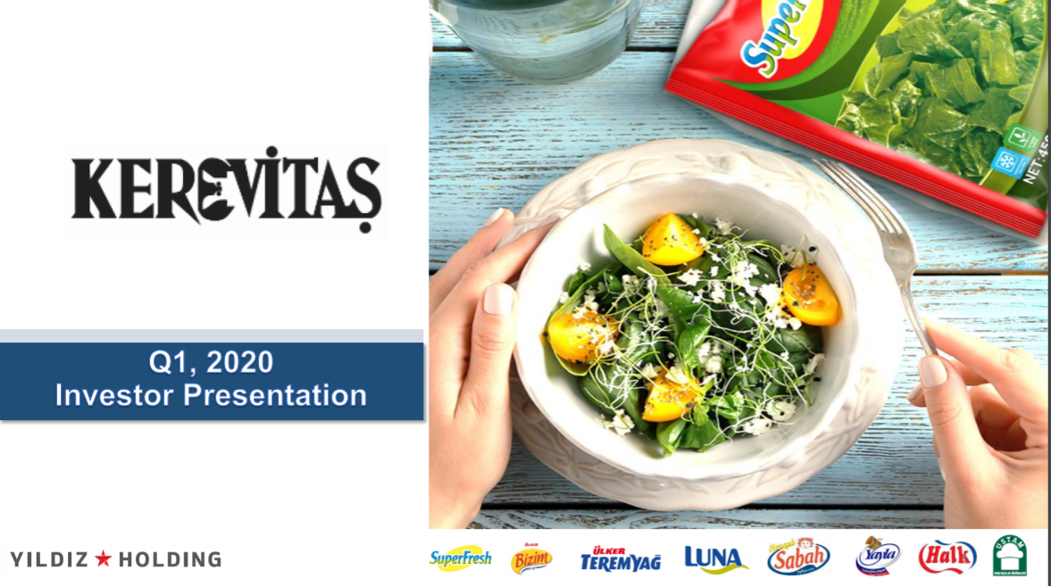


Investment Banking Pitchbook Template
COMPANY ANALYSIS & VALUATION

Slide 2
1
4
Table of Contents
Company Overview
Valuation
1. Company History and Principles
13. Income Statement Forecast
2. Frozen Food Products
14. PP&E Forecast
3. Oil & Margarine Products
15. Intangible Assets Forecast
4. General Overview
16. Working Capital Forecast
2
Financial Analysis
17. Debt & Tax Forecast
18. Balance Sheet Forecast
5. Balance Sheet
19. Cash Flow Forecast
6. Income Statement
20. WACC
7. Cash Flow Statement
21. Discounted Cash Flow Valuation
3
22. Multiples Valuation
Sector Analysis
5
8. General Trends
COVID-19 Effects
9. Sector Trends
23. Effect of COVID-19 on Frozen Food Industry
10. Regulatory Environment
24. Effect of COVID-19 on Kerevitaş
11. SWOT Analysis
Conclusion
12. Suggestions

Slide 3
Company Overview

Slide 4
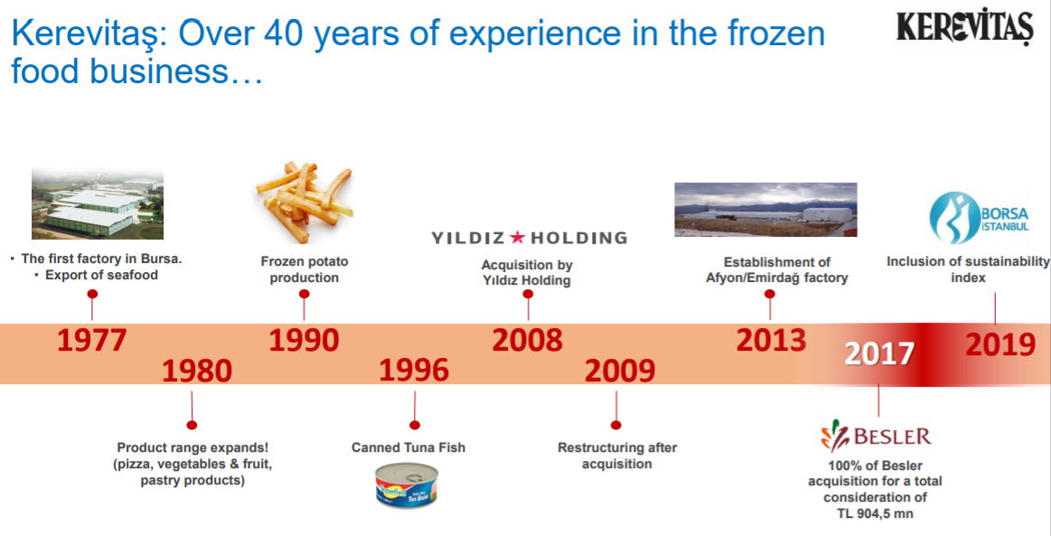
1
2
3
4
5
Company Overview
Industry Overview
Valuation
Transaction Opportunities
Team Overview

Slide 5
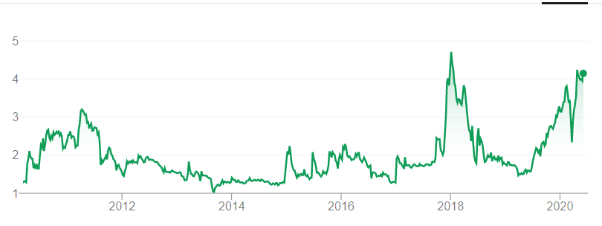
Kerevitaş Company Overview
Company History and Principles
Valuation & Share Performance
In 1990, Kerevitaş entered the Turkish frozen food market with its brand «SuperFresh» The company expanded its product range in 1993 and introduced the canned tuna to the market. Then, it enriched its product range with canned food products and ready-made food varieties. In 2008, Ülker acquired 51% of stakes for 20.3m YTL. Today, Kerevitaş has nearly 400 products in mass consumption and retail channel and it handles every stage of production, from raw material selection to the end consumer. One of the compaines that that are entitled to receive BRC (British Retail Consortium), ISO 22000 Food Safety Management System and ISO 9001 Quality Management System certificates. It successfully passed the audits by the AIB (American Institute of Baking) and also proved to be world-class with Good Manufacturing Practices (GMP). Vision: To be a leading food company that always satisfies our consumers, customers, employees, and shareholders and makes them smile. Mission: To be the leading and innovative brand, offering consumers, customers, and shoppers the most practical, freshest, most delicious products with a healthy and safe value chain. Principles: Consumer Satisfaction (to keep the needs and wishes of the customers in the first place and to produce accordingly), Quality (handle every stage of production with utmost care), Taste (ensure the superior taste and quality) , Technology (to be innovative and progressive.), Respect for Society (community values, legal regulations, and the environment), Product Diversity (to offer new products to consumers by considering the needs of them and trends of the market)
Key Valuation Statistics as of 31.12.2019(TRY)
Enterprise Value | 2.81b | Revenue (FY18e) | $968
Market Cap | 2.75b TRY | EBITDA (FY18e) | 379.35m
P/E | 17.29x | EBITDA Margin | 15%
EV/EBITDA | 7.4x | Debt / EV | 2,64%
Cash | 13.2m | Total Debt | 74.23m
BIST: KERVT | Current: 4.15 TRY | High/Low: 1.55 TRY/ 4.62 TRY
1
2
3
4
5
Company Overview
Financial Analysis
Sector Analysis
Valuation
COVID-19 Effects

Slide 6
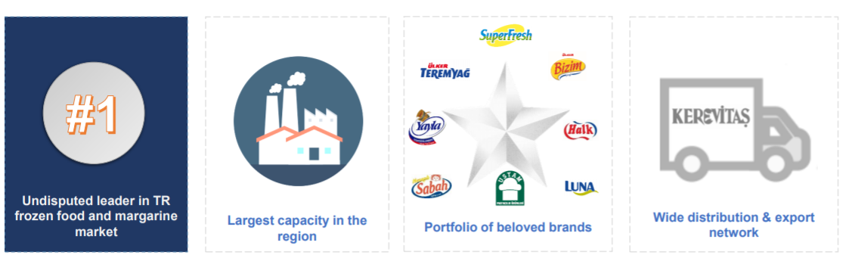
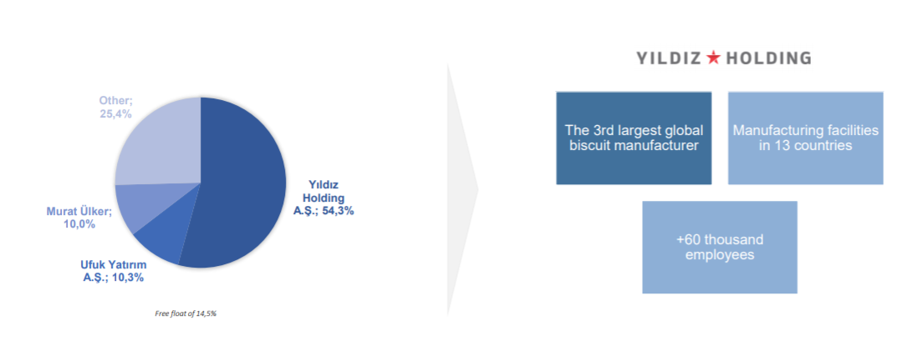
Strong and Supportive Shareholders
Source: Kerevitaş

Slide 7
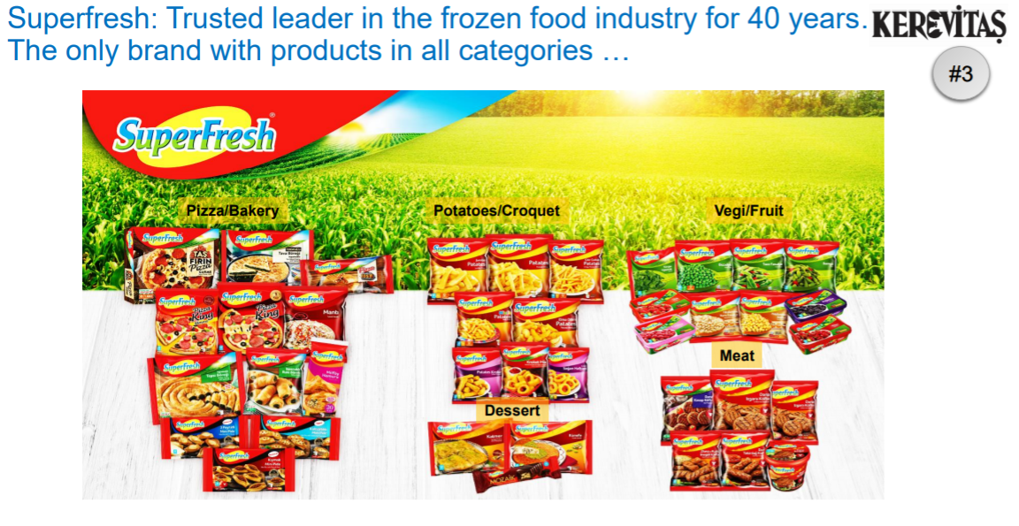
Frozen Food Products
Source: Kerevitaş

Slide 8
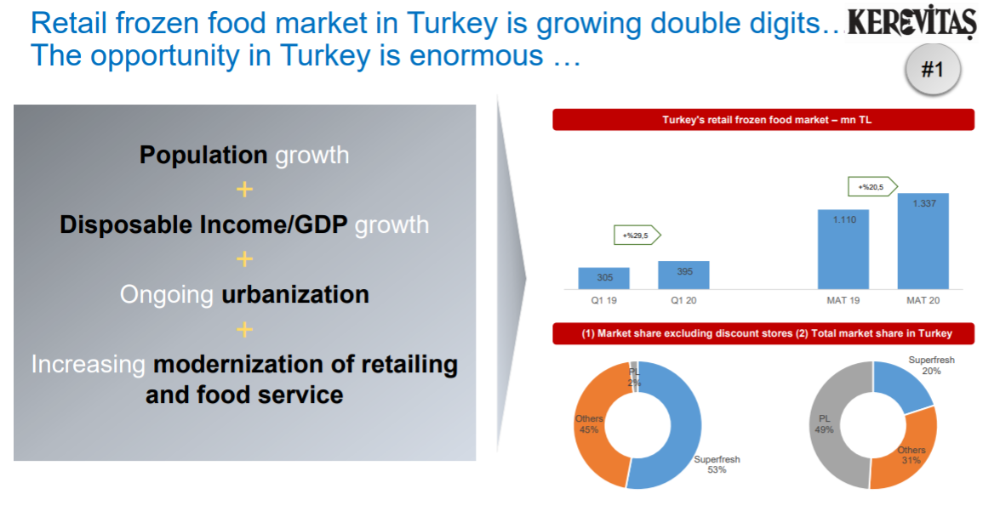
Kerevitaş Company Overview
Frozen Food Products
Products
1
2
3
4
5
Company Overview
Industry Overview
Valuation
Transaction Opportunities
Team Overview
Source: Kerevitaş

Slide 9
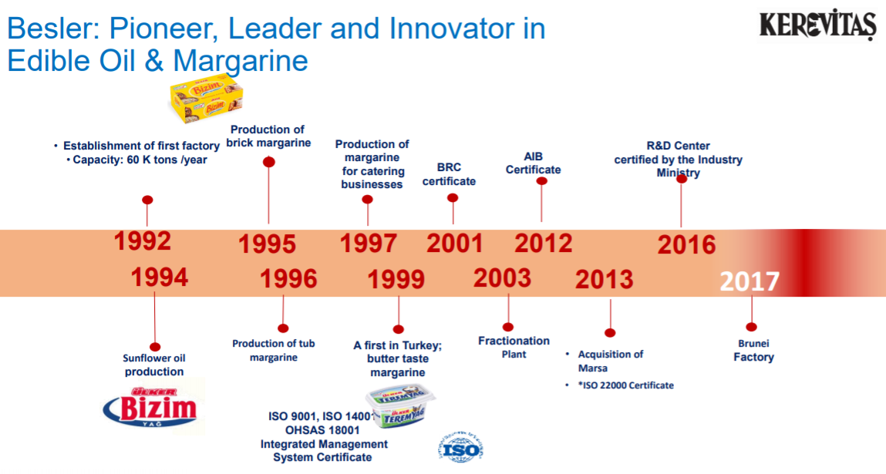
Oil & Margarine Products
Source: Kerevitaş

Slide 10
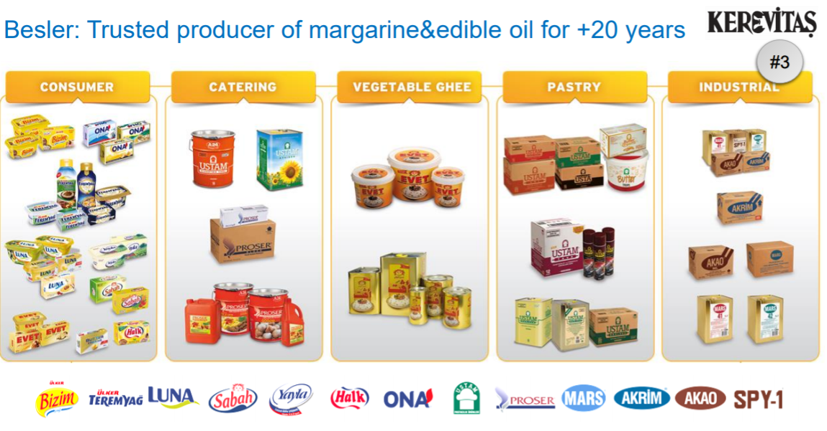
Oil & Margarine Products
Source: Kerevitaş

Slide 11
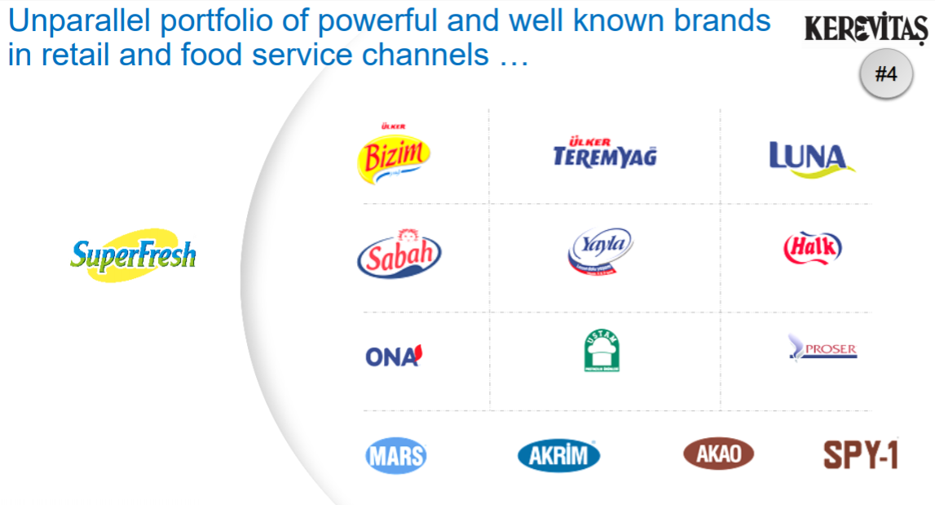
Oil & Margarine Products
Source: Kerevitaş

Slide 12
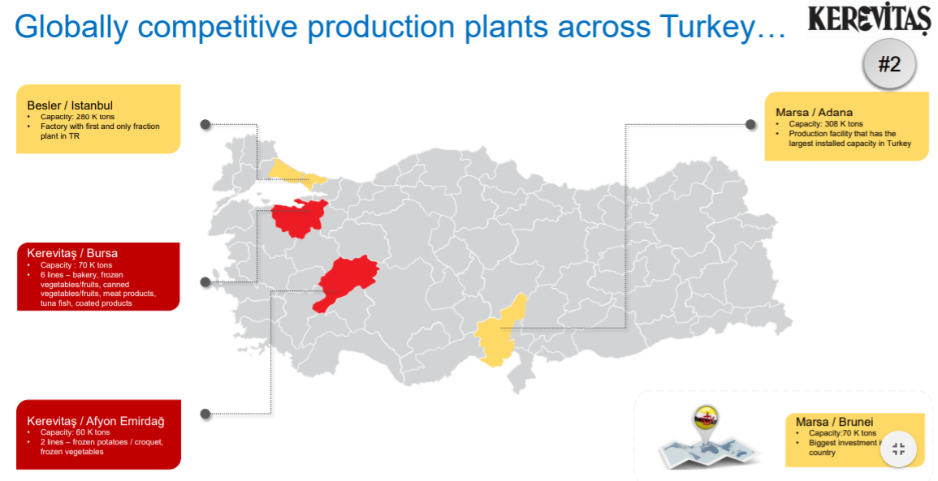
Oil & Margarine Products
Source: Kerevitaş

Slide 13
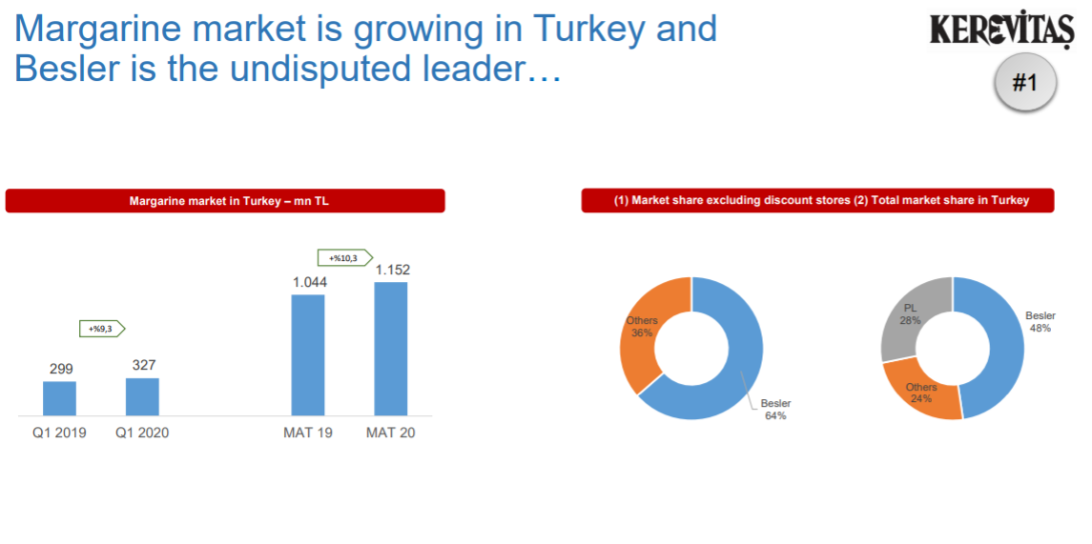
Oil & Margarine Products
Source: Kerevitaş

Slide 14
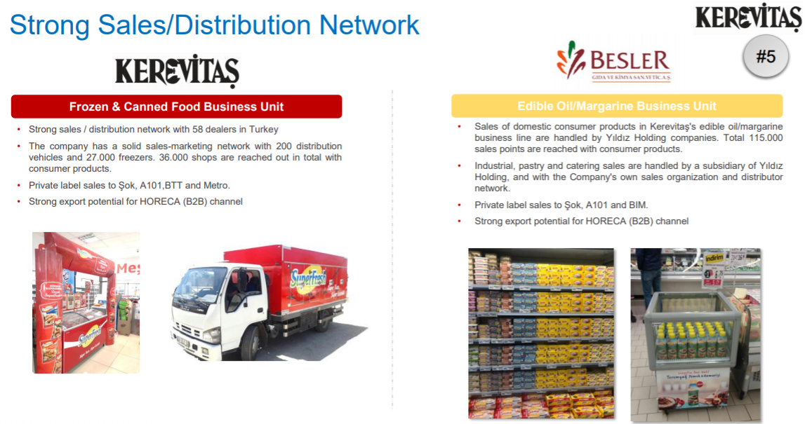
General Overview
Source: Kerevitaş

Slide 15
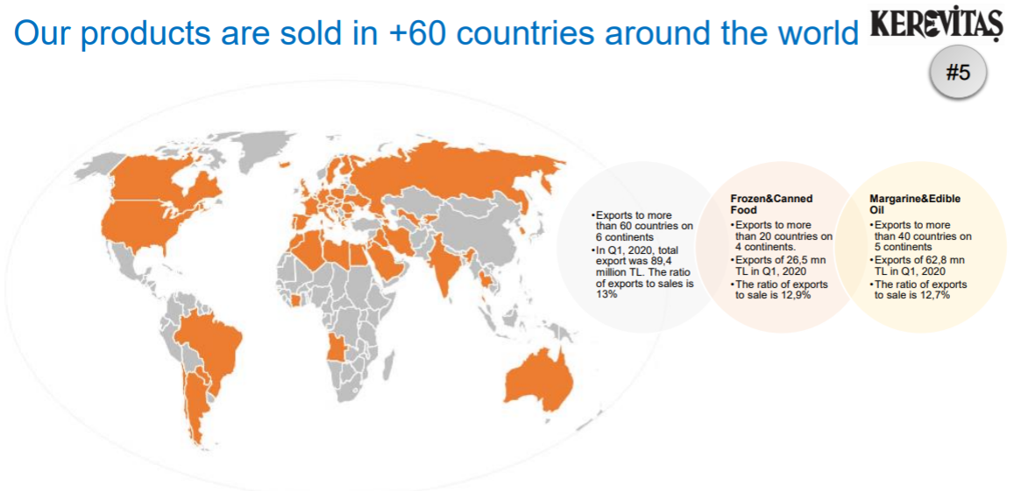
General Overview
Source: Kerevitaş

Slide 16
Financial Analysis

Slide 17
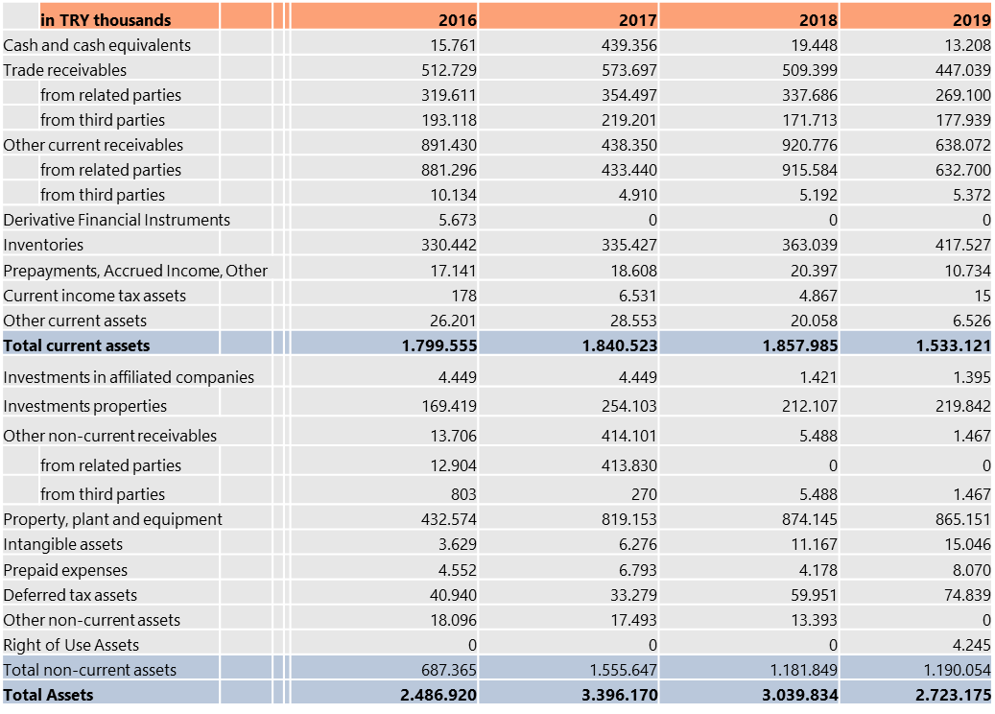
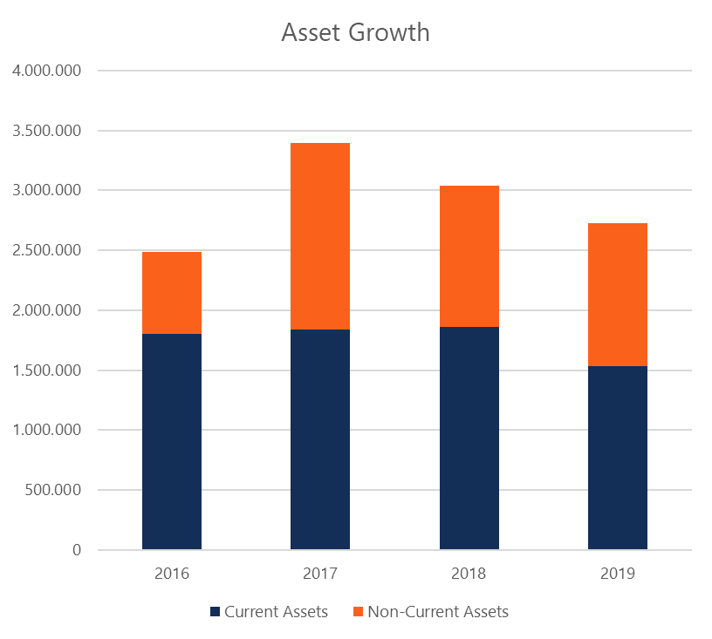
Financial Analysis
Operating Forecast
Balance Sheet - Assets
1
2
3
4
5
Company Overview
Financial Analysis
Sector Analysis
Valuation
COVID-19 Effects

Slide 18
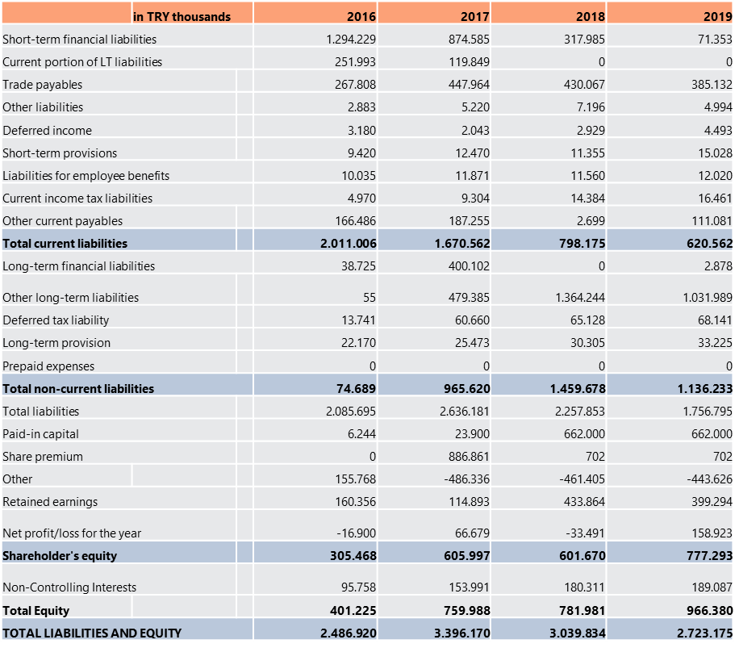
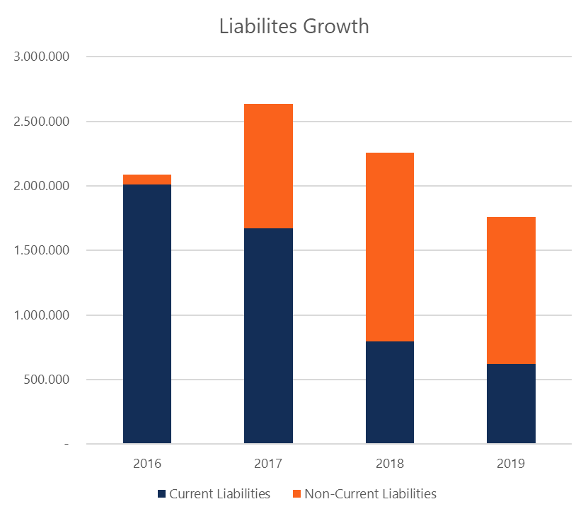
Financial Analysis
Operating Forecast
Balance Sheet - Liabilities
1
2
3
4
5
Company Overview
Financial Analysis
Sector Analysis
Valuation
COVID-19 Effects

Slide 19
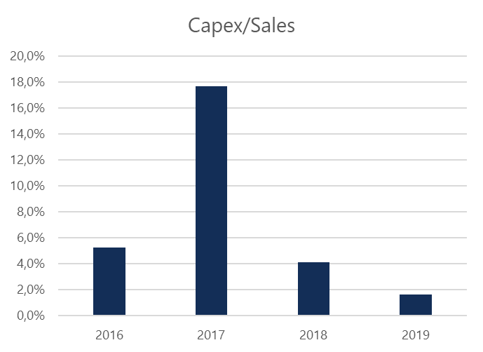
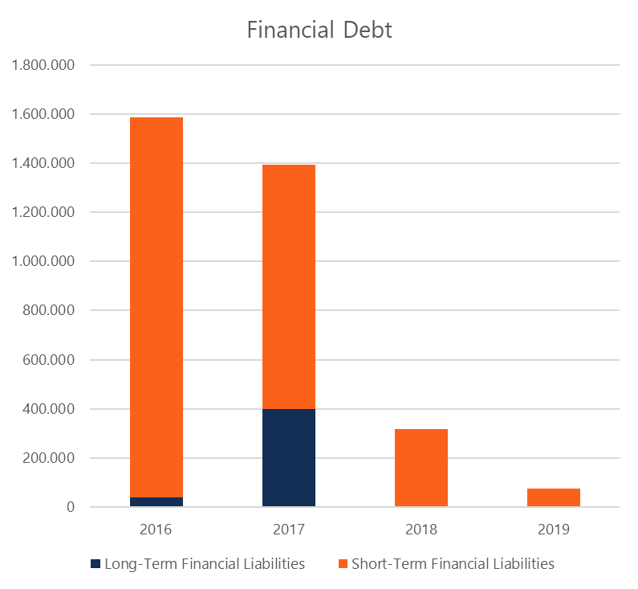
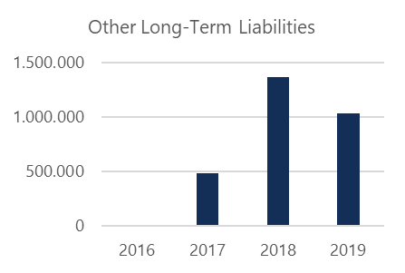
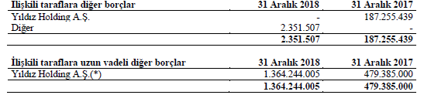
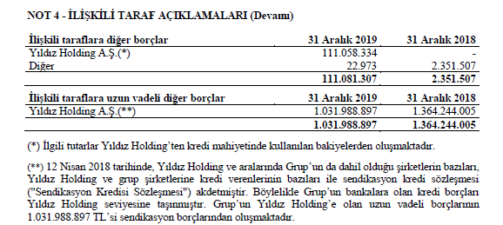
Financial Analysis
Operating Forecast
Balance Sheet Analysis
In the past three years, the firm’s balance sheet shrank from 3.4b TRY to 2.7b TRY. The current assets composed %54.1 of the total assets in 2017, while this ratio grew to 56.3% in 2019. 2% capex to sales ratio in 2019 and this ratio was 18% in 2017, a signal that the company have heavily upgraded its fixed assets in 2017. The company had long-term financial liabilities of 400.1m TRY and short-term financial liabilities of 994.4m TRY in 2017. In 2019, long-term financial liabilities decreased to 2.8m TRY and short-term liabilities decreased to 71.3m TRY. So the Financial Liabilities/Total Assets went from 41% to 2.7%, an incredible and unrealistic improvement. → 115% increase in other-long term liabilities.
-36% CAGR
BUT, the debt is hidden…
1
2
3
4
5
Company Overview
Financial Analysis
Sector Analysis
Valuation
COVID-19 Effects

Slide 20
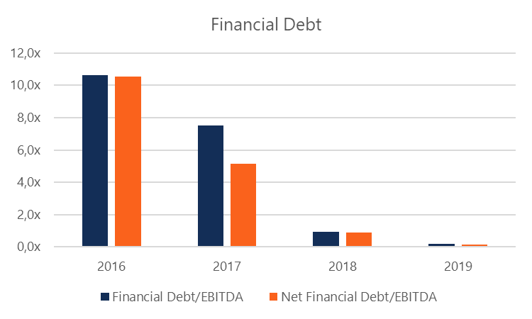
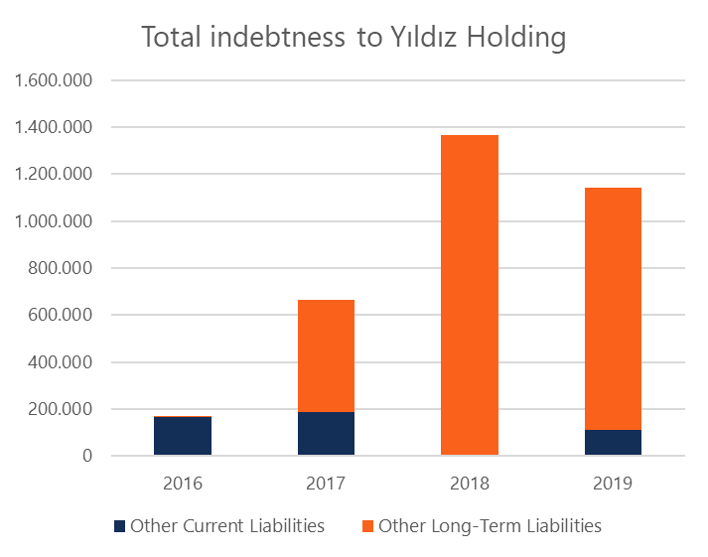
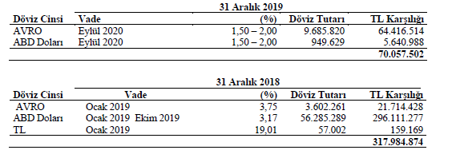
Financial Analysis
Operating Forecast
Balance Sheet Analysis
Kerevitaş benefited the cheap syndication credits and actually was able to transfer a large percentage of its financial liabilities to its parent company → Together with financial debt, the total amount is 2.07b TRY in 2017 and then it improved to 1.22b TRY, still a very good deleveraging period. Improvements in balance sheet: → Financial Debt/EBITDA : from 7.5x to 0.2x → Net Financial Debt/EBITDA : from 5.1x to 0.2x → Interest coverage ratio : from 0.9x to 2.2x 64.4m TRY is dominated in Euro, 5.6m TRY is dominated in USD Interest rate charged on these loans is between 1-2%, vulnerable to large FX fluctuations as the management has not taken any incentive to hedge the positions using financial instruments.
+90% CAGR
1
2
3
4
5
Company Overview
Financial Analysis
Sector Analysis
Valuation
COVID-19 Effects

Slide 21
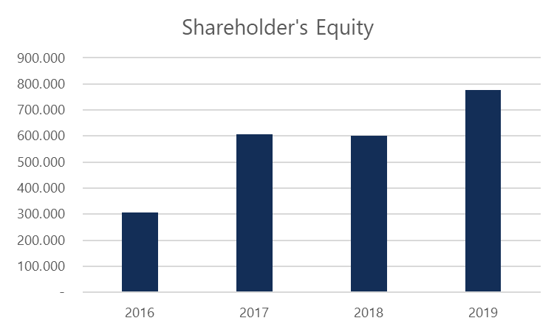
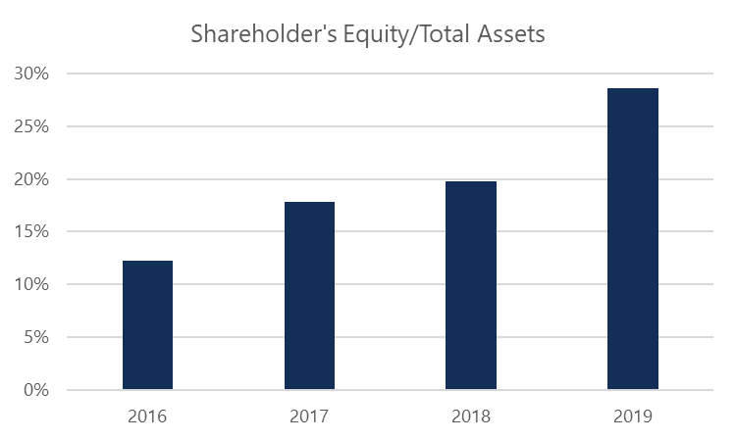
Financial Analysis
Operating Forecast
Balance Sheet Analysis
Equity ratio is not affected by this parent-subsidiary relationship. Real improvement in leverage → from 22% to 35% in the past three years. There has been no dividend distributions, helping the company improve its capitalization structure as the equity increased by 28.3% in just two years (from 760m TRY in 2017 to 966.4m TRY in 2019), a compounding annualized growth of 13.3%. The stress test made by the company shows how it can negatively affected by the FX fluctuations. → 10% devaluation in Turkish Lira would cause company to lose 31.6m TRY, as the firm has net exposure to FX fluctuations and it’s not naturally hedged. Interestingly, the management also chooses not to hedge it by using financial instruments.
+13.3% CAGR
1
2
3
4
5
Company Overview
Financial Analysis
Sector Analysis
Valuation
COVID-19 Effects

Slide 22
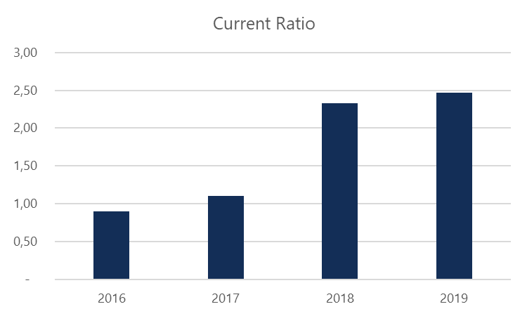
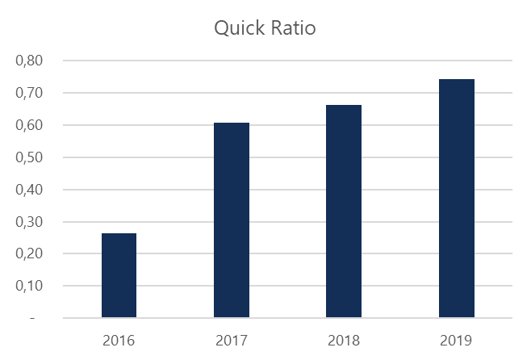
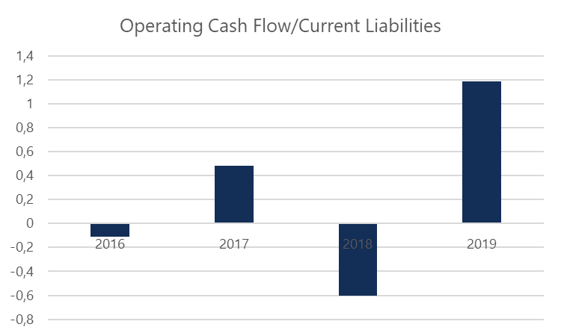
Financial Analysis
Operating Forecast
Balance Sheet - Liquidity
For two consecutive years before 2017, Kerevitaş had not been able to cover its current liabilities with its current assets as the current ratio had been 0.9x. From 2017 on, current ratio has significantly improved from 1.1x to 2.5x → a sign that the company can mitigate any short-term liquidity issues in case the need arises. The similar improvement in quick ratio level, significantly improved to 0.7x at the end of 2019, whereas the same levels were far from reality before 2017 when it was 0.3x. Kerevitaş has a stronger position in terms of operationg cash flow ratio, now able to cover all its current liabilities with the cash flow from operations All these ensure that the company is now better positioned for any shocks, whether it’s external or not.
1
2
3
4
5
Company Overview
Financial Analysis
Sector Analysis
Valuation
COVID-19 Effects

Slide 23
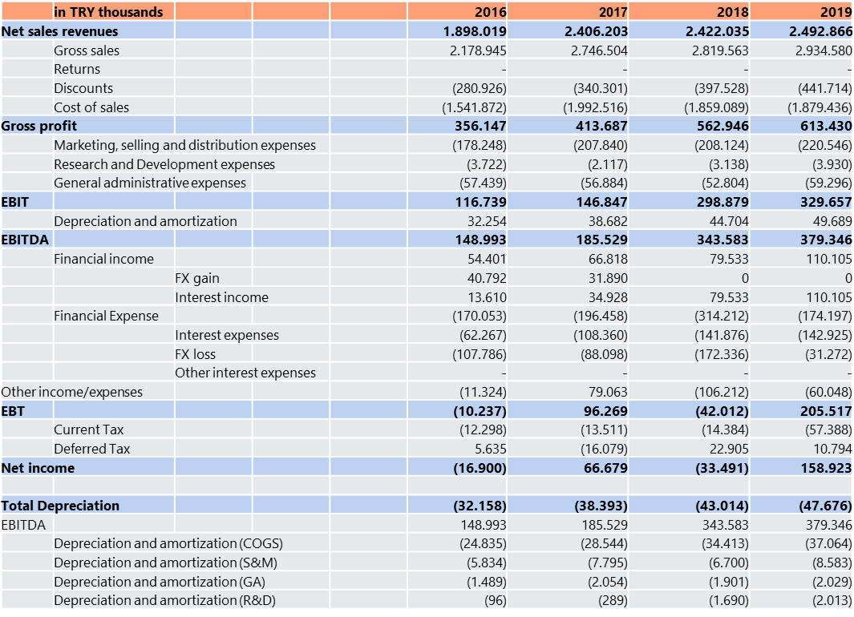
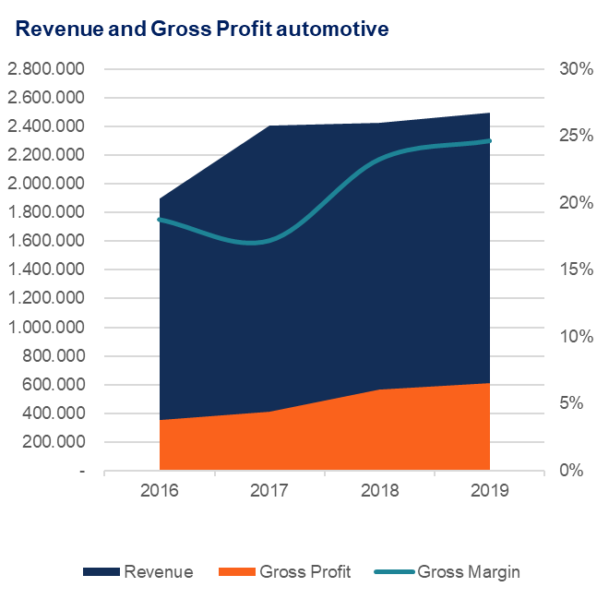
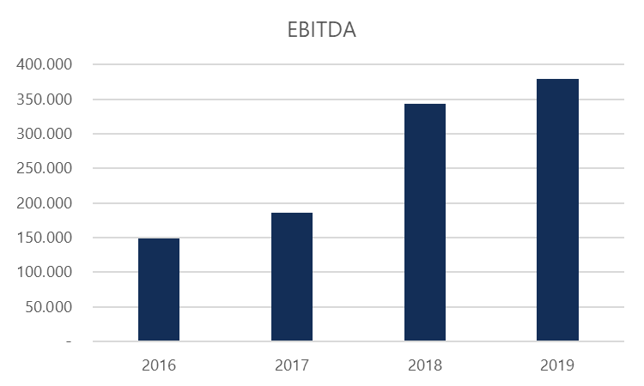
Financial Analysis
Operating Forecast
Income Statement
+36,5% CAGR
1
2
3
4
5
Company Overview
Financial Analysis
Sector Analysis
Valuation
COVID-19 Effects

Slide 24
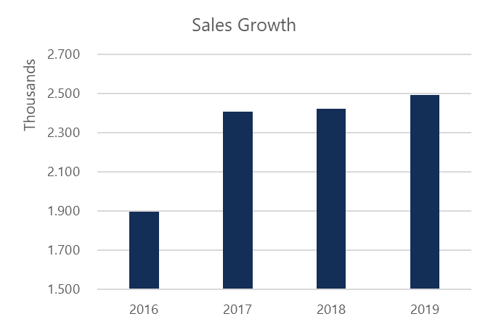
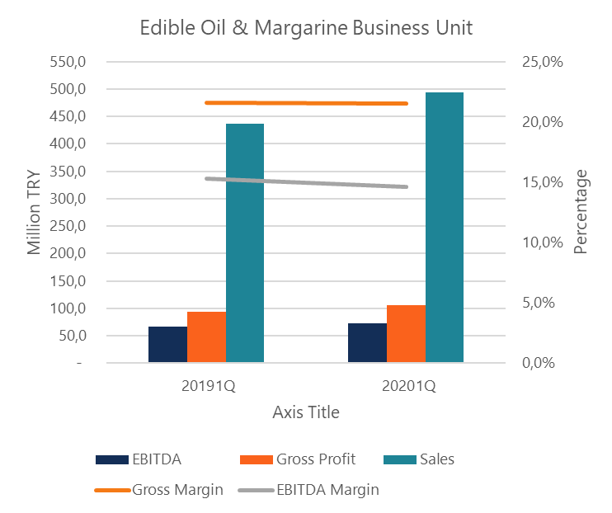
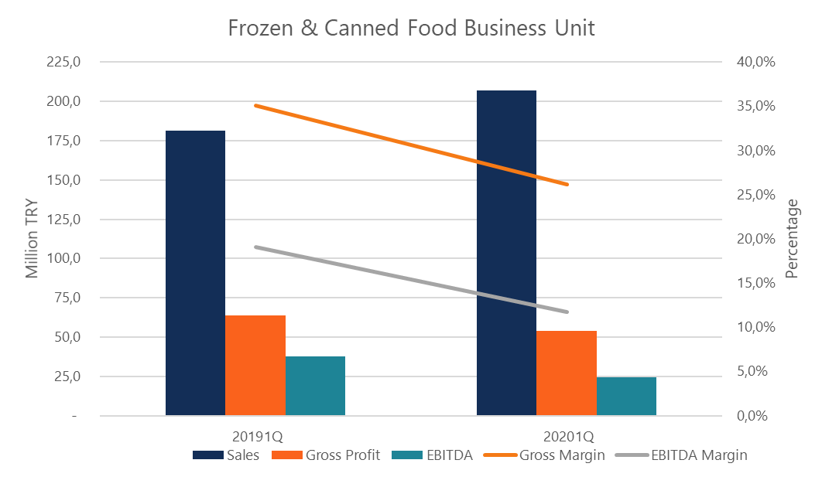
Financial Analysis
Operating Forecast
Income Statement
CAGR of 9.5% sales growth whereas the inflation compoundedly averaged at 13%. The fast-growing frozen food market is mainly responsible for the revenue growth →the firm maintains its competitive position in the market as it has 20% market share in frozen food market and 48% in oil market. → The management did a good job by keeping opex rate around 11% even though the opex requirements of growing frozen food sales is larger than that of oil products →clear in 1Q2020 operating report that the frozen foods’ gross margin and EBITDA margin are 26.2% and 11.7%, respectively, whereas oil&margarine segment’s gross margin and EBITDA margin stand at 21.5% and 14.6%, respectively). →covid-19 crisis is reflected very positively in 1Q2020 revenues of the firm as the growth was 29% and 10% in frozen food segment and edible oil&margarine segment respectively.
+9.5% CAGR
1
2
3
4
5
Company Overview
Financial Analysis
Sector Analysis
Valuation
COVID-19 Effects

Slide 25
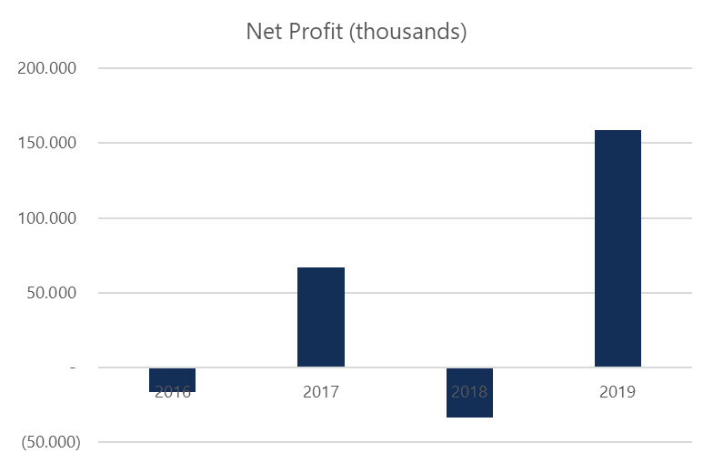
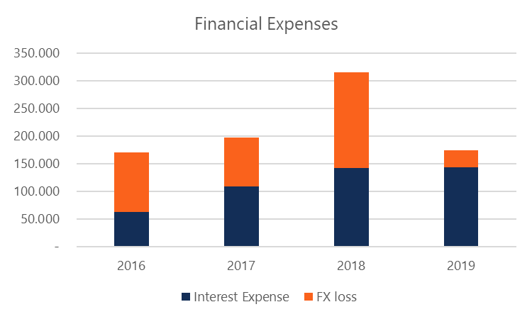
Financial Analysis
Operating Forecast
Income Statement
Gross Margin: from 19% to 25% EBITDA margin: from 8% to 15% Good margin ratios are not fully reflected in net profits as the firm used most of its income for its interest expenses (141.9m TRY) and it experienced a large FX loss (172.3m TRY) due to unprecedented fluctuations in August 2018. Kerevitaş faced a loss of 33.5m TRY out of 2.4b TRY sales in 2018, which is reflected as -1% margin. The year 2019 was better as the net margin was 6%, even better than 3% in 2017. So, 158.9m TRY net profit in 2019 was the highest profit the firm generated so far as the future prospects for Kerevitaş and its subsidiaries became brighter. Frozen food sales is capturing more of the total sales (from 25.9% to 29.4%). 11.5% of the sales came from exports in 2017 whereas this very slightly increased to %12 in 2019, despite the weaker Turkish Lira. Discount markets attract more customers year by year, so private label sales by Kerevitaş to Şok, A101 and BIM supports the growth of domestic sales
1
2
3
4
5
Company Overview
Financial Analysis
Sector Analysis
Valuation
COVID-19 Effects

Slide 26
Financial Analysis
Operating Forecast
Income Statement
1
2
3
4
5
Company Overview
Financial Analysis
Sector Analysis
Valuation
COVID-19 Effects

Slide 27
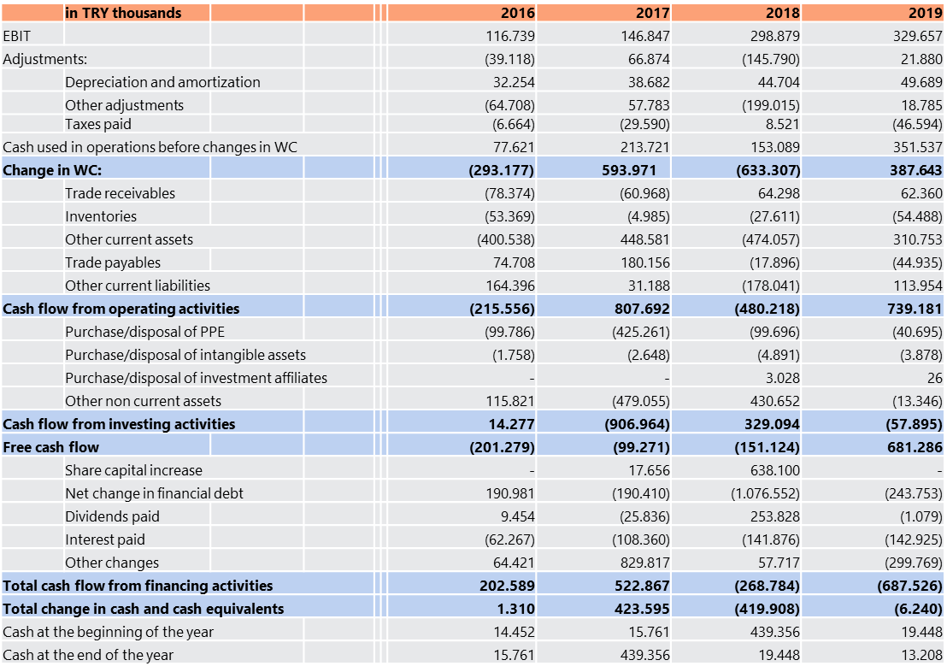
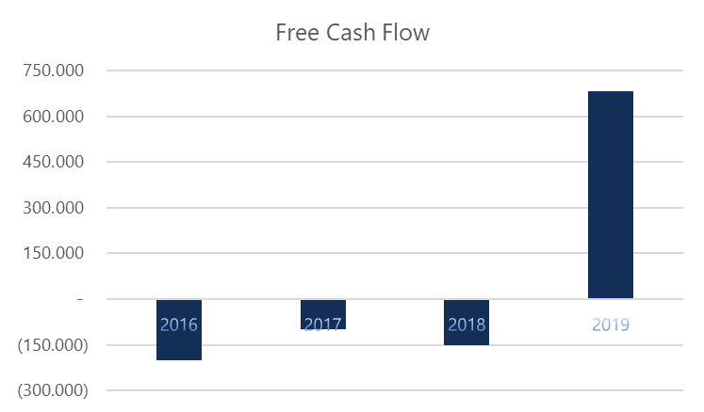
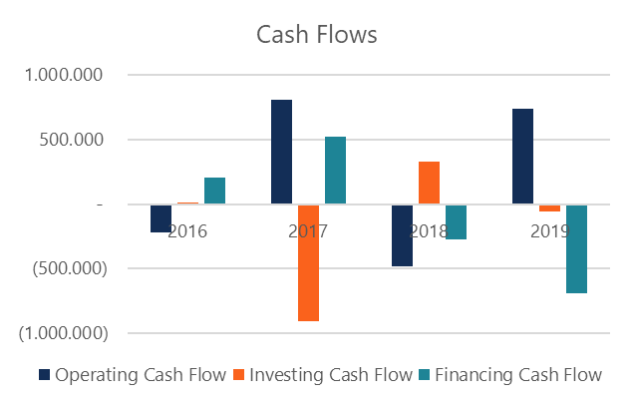
Financial Analysis
Operating Forecast
Cash Flow Statement
1
2
3
4
5
Company Overview
Financial Analysis
Sector Analysis
Valuation
COVID-19 Effects

Slide 28
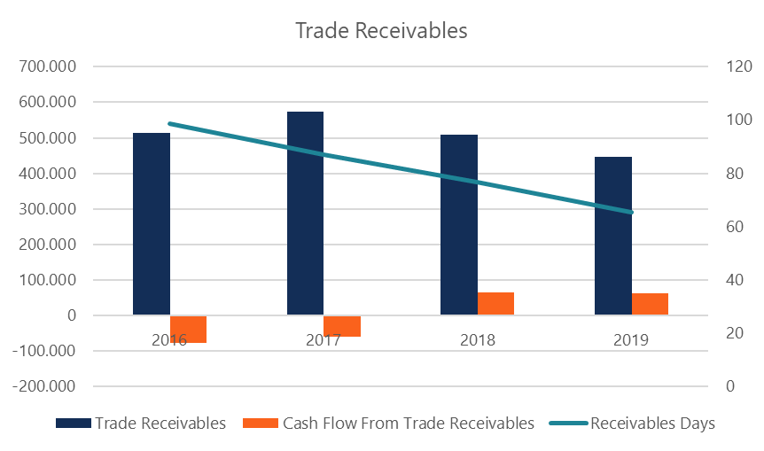
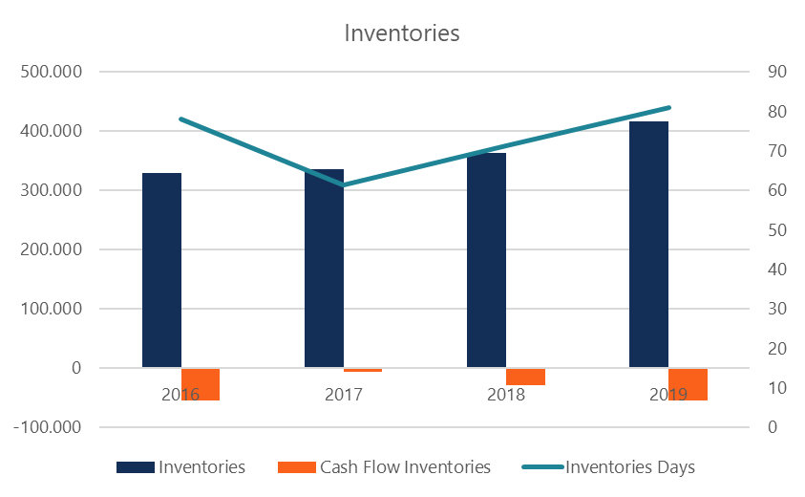
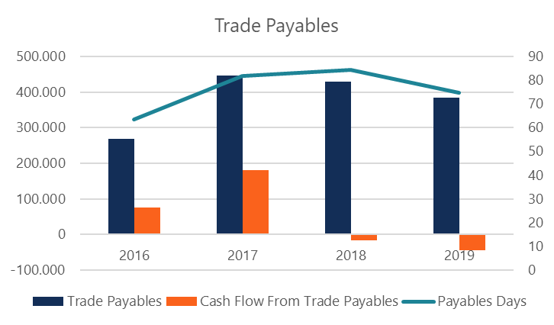
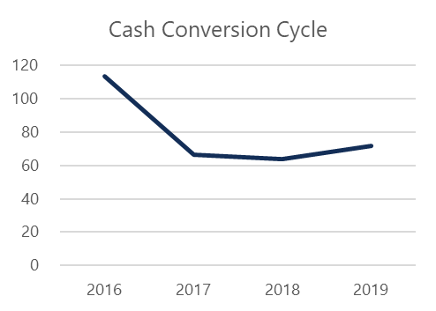
Financial Analysis
Operating Forecast
Cash Flow Statement – Operating Cash Flow
Operating cash flows are in a fluctuating pattern Other adjustments hit the company’s cash generation as FX loss was 172.3m TRY in 2018 → negative net income and a tax deferral for this year (8.5m TRY). The tax paid by the company was in all-time high levels (46.6m TRY) as the net income was high (158.9m TRY). In 2018, operating cash flow was negative (480.2m TRY) as the firm could not collect it’s other receivables from the third parties, → positive cash flow from trade receivables in both 2018 (64.3m TRY) and 2019 (62.4m TRY) whereas it was negative in 2017 (61m TRY) → stricter policy in accepting the payments in installments (account receivables days : 87 to 65) inventories steadily increased in these periods → long shelf life products are none of a concern in this regard (inventory days: 61 to 81) Paid down some of its payables (cash flow from trade payables: -17.9m in 2018 and -45m TRY in 2019), whereas it was +180.2m TRY in 2017 (account payables days: 82 to 75) Net increase of 6 days in cash conversion cycle (from 66 to 72 between 2017 and 2019) positive operating cash flow (739m TRY) in 2019, albeit not as much as in 2017 (807.7m TRY).
1
2
3
4
5
Company Overview
Financial Analysis
Sector Analysis
Valuation
COVID-19 Effects

Slide 29
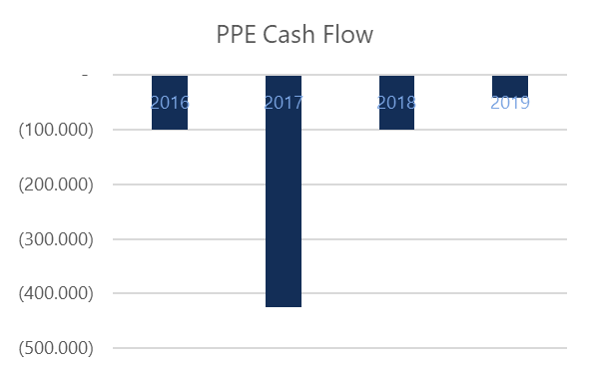
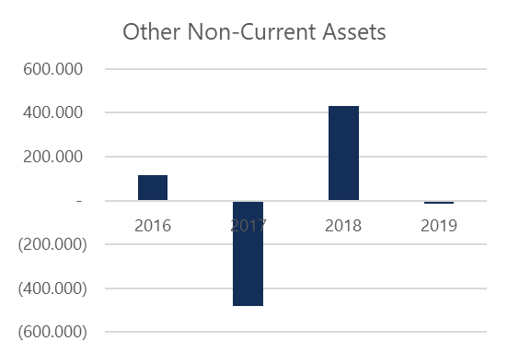
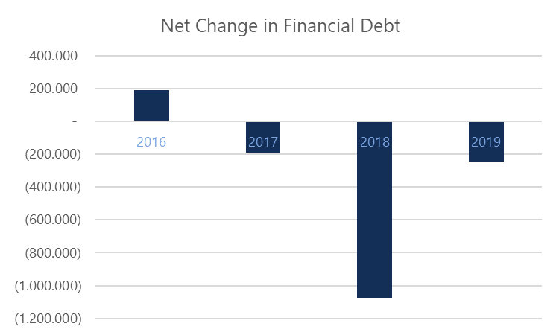
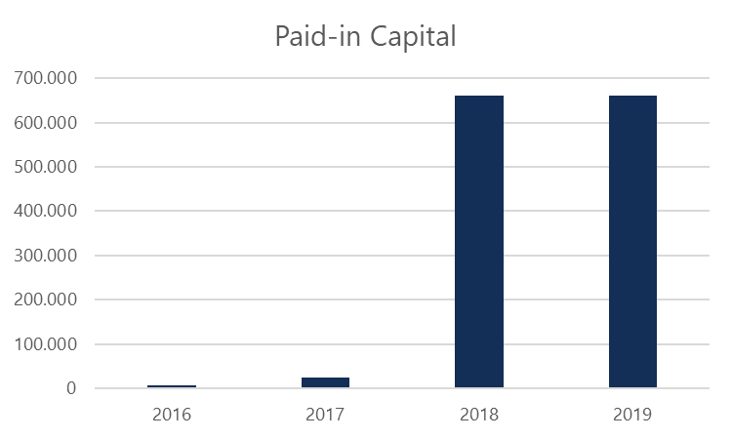
Financial Analysis
Operating Forecast
Cash Flow Statement – Cash Flow from Investing Activities and Cash Flow from Financing Activities
In 2017, used the cash from operations to invest in fixed assets and non-current assets → To improve its production capacity and technology for better future prospects → Capex was -425.3m TRY and cash flow from obtaining non-current assets was -479m TRY. → Increase in other changes + capital increase → Positive cash flow from financing activities amounted to 522.9m TRY In 2018, negative free cash flow (-151.2m TRY) → A large debt payment of 1.08b TRY, capital increase of 638.1m TRY → Increase in dividends cash flow of 253.9m TRY (the company used its internal resources, share premium, to increase capital and transfered 248.1m to retained earnings account) In 2019, again covered some of its financial debt (243.8m TRY) and other changes was equal to -299.8m TRY → The positive cash flow in this year used for the financial obligations and other financing needs.
1
2
3
4
5
Company Overview
Financial Analysis
Sector Analysis
Valuation
COVID-19 Effects

Slide 30
Sector Analysis

Slide 31
Sector Analysis
Operating Forecast
General Trends
According to TURKSTAT; → Accommodation and food service activities account in GDP has average growth rate of 20% (6% in $ ) between 2009-2018 → 22,41% of households' consumption expenditures goes Food and non-alcoholic beverages, on average, between 2002-2018. Standard deviation is 2,78 which means every year representative Turkish household will spend relatively big portion of their consumption on food. → Turkish population will grow with growth rate 1,16% on average between 2020-2025. So it will reach 88.845.000 in 2025. USDA’s Office of Agricultural Affairs, OAA; → Rising middle-class incomes and rising female labor force participation → High export potential due to geographic proximity to EU, Russian, and Middle Eastern markets → The growing food processing industry is looking for new, high quality, imported food ingredients → There is recognition of high-quality product and growth of high-end retail to support new product marketing.
1
2
3
4
5
Company Overview
Financial Analysis
Sector Analysis
Valuation
COVID-19 Effects
Source: https://www.foodexport.org/get-started/country-market-profiles/europe/turkey-country-profile

Slide 32
Sector Analysis
Operating Forecast
Sector Trends
7,617 food processing and 595 beverage producing enterprises in Turkey as of 2017 The food production industry constitutes 14.25% of all production industries as of 2017, and the beverage manufacturing industry is 0.70% of all manufacturing industries in Turkey. → Second largest manufacturing industry in Turkey after motor vehicles. → # of companies in food production has slowly and steadily been increasing over the past five years Food manufacturing/processing and food retail industries are the least impacted by economic stagnations. Sales growth is expected in the processed food industry in the upcoming years. → Large young population that is more inclined to eat processed food compared to the former generation → Increase in women’s participation in the workforce → Increase in the number of single-person households, increased consumption of packaged food and prepared meals. → More access to organized grocery chain, better access to a wider variety of processed, packaged, chilled, frozen and ready to eat food. In grocery store freezers: → Variety of pizzas, Turkish-style meat products such as different kinds of meatballs and kebabs, forms of prepared seafood dishes, local/ethnic kinds of bakery products like börek, and processed vegetables and fruits. → Ready to eat seafood and frozen bakery products are trendy, and more functional and flavored yogurts and kefirs are arriving in retailer refrigerators. Healthier, organic, and functional food options are on the rise.
1
2
3
4
5
Company Overview
Financial Analysis
Sector Analysis
Valuation
COVID-19 Effects
Source: https://www.fas.usda.gov/data/turkey-food-processing-ingredients-4

Slide 33
Sector Analysis
Operating Forecast
Regulatory Environment
“The Decree-Law on Production, Consumption, and Control of Food” and entered into force on 28.06.1995 → Aimed to prevent the mess and chaos in food services. Customs Union Agreement with the European Union → Important start in harmonizing our country's food legislation with the EU legislation 27.05.2004, Decree No. 5179 on the Production, Consumption, and Inspection of Foods The Law on the Adoption of Amendments” -→ “The provision of food safety” has been the direct aim of this Law. → In addition, a series of regulations and communiqués have been published under this Law to ensure food safety. The responsibility for the provision of food is given to food businesses, local authorities, municipalities and related units of the Ministry of Health are also assigned to carry out inspections within the framework of the procedures and principles to be determined by the Ministry Conclusion; Not a foreseeable risk is expected Yıldız Holding has strong ties with government and it has wide range of network. Turkish frozen food market and SuperFresh’s products comply with international standards.
1
2
3
4
5
Company Overview
Financial Analysis
Sector Analysis
Valuation
COVID-19 Effects

Slide 34
Sector Analysis
Operating Forecast
SWOT Analysis
STRENGTHS Strong Brand «SuperFresh» Diverse product ranges. The diversified product portfolio provides a strong competitive position. Strong sales, distribution, and export network. Thanks to the strong and effective delivery system, consumers easily access their productions. Strong production infrastructure Strong parent company Thanks to the young population and an increase in the number of working women, the consumption of SuperFresh has increased. WEAKNESSES Frozen food productions are generally expensive in contrast to other production. Also, the substitute goods of SuperFresh are expensive. Therefore, the price policy of frozen foods has continued in this direction. Advertisements and price promotions are so limited Even though Kerevitaş Gıda has a long history in the food industry, its competitors are able to product substitutes of its production in the short term by using technological innovations and Kerevitaş does not take an action against it within Turkey
OPPORTUNITIES Decrease in the interest rate and expanding credit resources, as well as opening borders, lead to new opportunities in the sector. Depreciation in the local currency Government promotions in agricultural sectors Increasing consumer base after COVID-19 THREATS Competitive policies that are applied by companies in the frozen food industry Lack of sufficient raw materials and its qualities may lead to various problems including a decrease in quality of productions. Change in consumer preferences because of substitution goods may damage consumer loyalty, which causes to loss of consumers. Competitors (Pınar, Penguen, Feast) have strong financial potentials, innovative and strong management teams, which may lead to loss of priority in the sector
1
2
3
4
5
Company Overview
Financial Analysis
Sector Analysis
Valuation
COVID-19 Effects

Slide 35
Sector Analysis
Operating Forecast
SUGGESTIONS
POTENTIAL MITIGATIONS TO ADRESS RISKS Focusing on strong networks providing sufficient raw materials. Moreover, testing the quality of raw materials is important. Analyzing potential outcomes of competitors’ actions and making policies to ensure consumers' loyalty. Embracing innovative solutions as well as investing technological tools may decrease the risk of loss of priority in the sector. Advertising policies may include foreign potential markets.
SUGGESTIONS To ensure stability in the sector, agricultural policies should be made. To improve the sector, production policies should be made. To eliminate problems of access to raw materials, legal regulations should be made. To provide raw materials for the sector, agricultural promotion should be focused.
1
2
3
4
5
Company Overview
Financial Analysis
Sector Analysis
Valuation
COVID-19 Effects

Slide 36
Valuation

Slide 37



Valuation
Operating Forecast
Income Statement Forecast
Assumptions Inflation expectation for the long term is around 10% Kerevitaş will grow +2% added to inflation → Momentum sales after covid-19 and growing customer base Gross margin always will be the average of the previous 5 years Opex will be the same as 2019.
1
2
3
4
5
Company Overview
Financial Analysis
Sector Analysis
Valuation
COVID-19 Effects

Slide 38

Valuation
Operating Forecast
PP&E Forecast
Assumptions Avg. Capex/sales in the last two years= 3% Maintenance expense/sales = 0,18% in 2019. Depreciation rate for Buildings / Total Buildings = 2% in 2019. Depreciation rate for Machineries/ Total Machineries= 6% in 2019. Depreciation rate for Other / Total Other = 10% in 2019.
1
2
3
4
5
Company Overview
Financial Analysis
Sector Analysis
Valuation
COVID-19 Effects

Slide 39

Valuation
Operating Forecast
Intangible Assets Forecast
Assumptions Average growing rate of intangible assets is 0,2% Depreciation rate for Rights / Total Rights = 7% in 2019. Depreciation rate for Dev. Cost/ Total Dev. Cost. = 11% in 2019. Depreciation rate for Other / Total Other = 25% in 2019.
1
2
3
4
5
Company Overview
Financial Analysis
Sector Analysis
Valuation
COVID-19 Effects

Slide 40

Valuation
Operating Forecast
Working Capital Forecast
Assumptions All variables will equal to the historical values.
1
2
3
4
5
Company Overview
Financial Analysis
Sector Analysis
Valuation
COVID-19 Effects

Slide 41



Valuation
Operating Forecast
Debt & Tax Forecast
Assumptions Turkey 10Y Government Bond has a 11.770% yield. 10 Years vs 2 Years bond spread is 355.5 bp. Short term commercial credit rate will be averaged %8.5 For long term loan, we can basically add the spread of the yield curve
1
2
3
4
5
Company Overview
Financial Analysis
Sector Analysis
Valuation
COVID-19 Effects

Slide 42


Valuation
Operating Forecast
Balance Sheet Forecast
BALANCE SHEET - TL '000 |  |  |  |  | 2019 | 2020 | 2021 | 2022 | 2023 | 2024 | 2025
 |  |  |  |  | Historical | Projected | Projected | Projected | Projected | Projected | Projected
Cash and cash equivalents |  |  |  |  | 13.208 | 44.392 | 58.719 | 93.172 | 167.345 | 258.759 | 356.201
Trade receivables |  |  |  |  | 447.039 | 500.684 | 560.766 | 628.058 | 703.424 | 787.835 | 882.376
Inventories |  |  |  |  | 417.527 | 481.993 | 547.280 | 609.132 | 674.354 | 756.502 | 851.914
Other current assets |  |  |  |  | 655.347 | 733.988 | 822.067 | 920.715 | 1.031.201 | 1.154.945 | 1.293.538
Total current assets |  |  |  |  | 1.533.121 | 1.761.056 | 1.988.832 | 2.251.077 | 2.576.324 | 2.958.041 | 3.384.028
Property, plant and equipment |  |  |  |  | 865.151 | 906.618 | 949.559 | 994.151 | 1.040.592 | 1.089.104 | 1.139.936
Intangible assets |  |  |  |  | 15.046 | 12.227 | 9.402 | 6.572 | 3.736 | 895 | -1.952
Other non-current assets |  |  |  |  | 309.858 | 309.858 | 309.858 | 309.858 | 309.858 | 309.858 | 309.858
Total non-current assets |  |  |  |  | 1.190.054 | 1.228.703 | 1.268.819 | 1.310.581 | 1.354.186 | 1.399.857 | 1.447.841
Total Assets |  |  |  |  | 2.723.175 | 2.989.759 | 3.257.651 | 3.561.658 | 3.930.510 | 4.357.898 | 4.831.870
Short-term financial liabilities |  |  |  |  | 71.353 | 91.353 | 111.353 | 131.353 | 151.353 | 171.353 | 191.353
Current portion of LT liabilities |  |  |  |  | - | - | - | - | - | - | -
Trade payables |  |  |  |  | 385.132 | 444.597 | 504.818 | 561.872 | 622.033 | 697.807 | 785.817
Other current liabilities |  |  |  |  | 164.077 | 189.410 | 215.066 | 239.373 | 265.003 | 297.285 | 334.779
Total current liabilities |  |  |  |  | 620.562 | 725.360 | 831.238 | 932.597 | 1.038.388 | 1.166.446 | 1.311.949
Long-term financial liabilities |  |  |  |  | 2.878 | 6.303 | 8.242 | 8.994 | 8.795 | 7.836 | 6.269
Other long-term liabilities |  |  |  |  | 1.133.355 | 1.051.409 | 969.463 | 887.517 | 805.571 | 723.625 | 641.679
Total non-current liabilities |  |  |  |  | 1.136.233 | 1.057.711 | 977.705 | 896.510 | 814.366 | 731.461 | 647.947
Total liabilities |  |  |  |  | 1.756.795 | 1.783.071 | 1.808.942 | 1.829.108 | 1.852.754 | 1.897.906 | 1.959.896
Paid-in capital |  |  |  |  | 662.000 | 662.000 | 662.000 | 662.000 | 662.000 | 662.000 | 662.000
Share premium |  |  |  |  | 702 | 702 | 702 | 702 | 702 | 702 | 702
Other |  |  |  |  | (443.626) | (443.626) | (443.626) | (443.626) | (443.626) | (443.626) | (443.626)
Retained earnings |  |  |  |  | 399.294 | 537.126 | 777.372 | 1.019.332 | 1.303.112 | 1.648.257 | 2.030.431
Net profit/loss for the year |  |  |  |  | 137.832 | 240.247 | 241.960 | 283.780 | 345.144 | 382.175 | 411.920
Shareholder's equity |  |  |  |  | 756.202 | 996.448 | 1.238.408 | 1.522.188 | 1.867.333 | 2.249.507 | 2.661.427
Non-Controlling Interests |  |  |  |  | 210.178 | 210.178 | 210.178 | 210.178 | 210.178 | 210.178 | 210.178
Total Equity |  |  |  |  | 966.380 | 1.206.626 | 1.448.586 | 1.732.367 | 2.077.511 | 2.459.686 | 2.871.606
TOTAL LIABILITIES AND EQUITY |  |  |  |  | 2.723.175 | 2.989.698 | 3.257.528 | 3.561.474 | 3.930.265 | 4.357.592 | 4.831.502
Assumptions Non forecastable items will stay the same
+10% CAGR
Forward Equity/Assets
55%
+22% CAGR
1
2
3
4
5
Company Overview
Financial Analysis
Sector Analysis
Valuation
COVID-19 Effects

Slide 43



Valuation
Operating Forecast
Cash Flow Forecast
Diverging to the long term mean*
1
2
3
4
5
Company Overview
Financial Analysis
Sector Analysis
Valuation
COVID-19 Effects

Slide 44
Valuation
Operating Forecast
WACC
WACC (Cost of Capital)
 |  | Equity | Financial Debt | Capital
Book Value as of Dec 2019 |  | 756.202 | 74.232 | 830.433
Weight in Cost of Capital |  | 91% | 9% | 100%
Cost of components |  | 14,8% | 6,7% | 14,1%
Assumptions US 10Year = 0.68% Turkey inflation = 10% CDS 10 Year Turkey = 5.5% Risk-free Rate = 0.68% + 10% Expected Market Return = Risk-free + CDS CFA Institute suggests adding the inflation rate differential between the local economy and a developed nation and using that as a spread on top of that same developed nation's long-term bond yield.
Rd (Cost of Debt)
Corporate tax rate (%) |  | 22%
 |  | Interest margin (%)
ST debt | 71.353 | 8,50%
LT debt | 2.878 | 12,00%
Rd | 8,6%
Rd * (1-Tc) (Cost of debt after tax) | 6,7%
Re (Cost of Equity)
Risk free rate (Rf) |  | 10,68%
Expected market return (Rm) |  | 16,18%
UL Beta (Bu) |  | 0,70
Levered Beta (Bl) |  | 0,75
Cost of equity (Re) |  | 14,8%
1
2
3
4
5
Company Overview
Financial Analysis
Sector Analysis
Valuation
COVID-19 Effects

Slide 45


Valuation
Operating Forecast
Discounted Cash Flow Valuation
Sales |  |  | TL'000 |  | 2.792.010 | 3.127.051 | 3.502.297 | 3.922.573 | 4.393.281 | 4.920.475
Total Costs |  |  |  |  | (2.476.741) | (2.807.475) | (3.127.172) | (3.466.986) | (3.888.543) | (4.376.017)
EBITDA |  |  |  |  | 365.424 | 378.911 | 444.742 | 536.719 | 598.765 | 652.928
EBITDA margin (%) |  |  |  |  | 13% | 12% | 13% | 14% | 14% | 13%
Tax Paid |  |  |  |  | (67.762) | (68.245) | (80.041) | (97.348) | (107.793) | (116.183)
Change in net working capital |  |  |  |  | (111.955) | (127.570) | (146.432) | (165.283) | (182.246) | (203.042)
A/R |  |  |  |  | (53.645) | (60.082) | (67.292) | (75.367) | (84.411) | (94.540)
Inventory |  |  |  |  | (64.466) | (65.287) | (61.852) | (65.221) | (82.149) | (95.412)
A/P |  |  |  |  | 59.464 | 60.222 | 57.054 | 60.161 | 75.775 | 88.009
Other Assets/Liabilities |  |  |  |  | (53.308) | (62.423) | (74.342) | (84.856) | (91.462) | (101.099)
Cash flow from operating activities |  |  |  |  | 185.707 | 183.096 | 218.269 | 274.087 | 308.726 | 333.703
Capital Expenditure |  |  |  |  | (83.760) | (93.812) | (105.069) | (117.677) | (131.798) | (147.614)
Maintenance Expenses |  |  |  |  | (4.981) | (5.579) | (6.249) | (6.998) | (7.838) | (8.779)
Disposal of assets |  |  |  |  | - | - | - | - | - | -
Other non-current assets |  |  |  |  | - | - | - | - | - | -
Cash flow from financing activities |  |  |  |  | (88.742) | (99.391) | (111.317) | (124.676) | (139.637) | (156.393)
Free cash flow |  |  |  |  | 96.965 | 83.706 | 106.951 | 149.412 | 169.089 | 177.310
WACC (Cost of Capital) |  |  |  |  | 14,1% | 14,1% | 14,1% | 14,1% | 14,1% | 14,1%
Cumulative discount factor |  |  |  |  | 1,00 | 0,88 | 0,77 | 0,67 | 0,59 | 0,52
Present Value of Free Cash Flow |  |  |  |  | 96.965 | 73.360 | 82.149 | 100.579 | 99.758 | 91.680
Last time the stock hit 2.18₺: 28.08.2019
1
2
3
4
5
Company Overview
Financial Analysis
Sector Analysis
Valuation
COVID-19 Effects

Slide 46








Valuation
Operating Forecast
Multiples Valuation
EV/EBITDA in the food sector is 14,26
(http://pages.stern.nyu.edu/~adamodar/New_Home_Page/datafile/vebitda.html)
1
2
3
4
5
Company Overview
Financial Analysis
Sector Analysis
Valuation
COVID-19 Effects

Slide 47

Valuation
Multiples Valuation
According to EV/EBITDA multiple based valuation, the entry equity value of the firm is 4.356.737 TL.
EV/EBITDA multiple of Kerevitaş Gıda (7,24x) is less than the average of market (14,26x) and our sample (11,65x), which is not good.
Generally the EV/EBITDA multiple is expected that it is the same with market mean.
Revenue growth and EBITDA have been increasing. Therefore, Kerevitaş still can be regarded as a profitable company.
Share price according to this valuation: 6,23 TRY
1
2
3
4
5
Company Overview
Financial Analysis
Sector Analysis
Valuation
COVID-19 Effects

Slide 48
COVID-19 EFFECTS

Slide 49
COVID-19 Effects
Operating Forecast
Effect of COVID-19 on Frozen Food Industry
Because of COVID-19, people began to stockpile food and long-term storability of frozen foods, which leads to increase in sales of frozen foods.
People prefer to frozen food since frozen food and ready-to-cook meals come in a packed form and do not require much effort or time to cook.
Frozen food can be stored for a certain period at home, which increases the demand for frozen food during that period.
1
2
3
4
5
Company Overview
Financial Analysis
Sector Analysis
Valuation
COVID-19 Effects

Slide 50

COVID-19 Effects
Operating Forecast
Effect of COVID-19 on Kerevitaş
People in Turkey began to cook in their homes. Therefore, even if restaurants and cafes are closed, Turkey’s retail frozen food market has increased by about 20% during the first quarter of 2020.
Kerevitaş Gıda increased its sales by 13% in contrast to sales in Q12020 whereas gross profit margin declined a little bit due to Covid-19.
1
2
3
4
5
Company Overview
Financial Analysis
Sector Analysis
Valuation
COVID-19 Effects

Slide 51
Conclusion

Slide 52
Conclusion
Operating Forecast
Final Notes
The fast-growing frozen food market is mainly responsible for the revenue growth and the firm maintains its competitive position in the market as it has 20% market share in frozen food market and 48% in oil market
Gross margin and EBITDA margin improved healthly from 19% to 25% in the past years, signaling a good operational performance.
Improvements in balance sheet:
→ Financial Debt/EBITDA : from 7.5x to 0.2x
→ Net Financial Debt/EBITDA : from 5.1x to 0.2x
→ Interest coverage ratio : from 0.9x to 2.2x
Momentum sales are expected after COVID-19
Strong parent company, good synergies and network

Slide 53
Conclusion
Final Notes
Strength
→ Strong sales, distribution, and export network. Thanks to the strong and effective delivery system, consumers easily access their productions.
Weakness
→Advertisements and price promotions are so limited
Opportunity
→Decrease in the interest rate and expanding credit resources, as well as opening borders, lead to new opportunities in the sector.
According to valuation, EBITDA and Gross Profit will continue to increase; therefore, Kerevitaş will generate cash flow.
However, there is mistmatch between DCF (1.44b TRY) and Multiples (4.12b TRY).

Slide 54
Thank YOU!

